Slide 1
Software Project Management

Slide 2
Contents
Project Scheduling
CPM (Critical Path Method )
Network Analysis
PDM (Precedence Diagram Method )
Lead and Lag
Critical path
Gantt Chart

Slide 3
Project Scheduling
An activity in which you decide how you will divide the project into the smaller tasks.
You also how these task will be executed
How much time a task will to complete

Slide 4
CPM(Critical Path Method)
Critical path method is a diagram which shows the sequence of activities of a project along with ES (Earliest start) and EF (Earliest finish).
Where as ES is the Earliest Start and EF is the Earliest Finish time of a activity in the critical path method Diagram.
Why this Diagram?
We develop this diagram to find out the critical path of project.

Slide 5
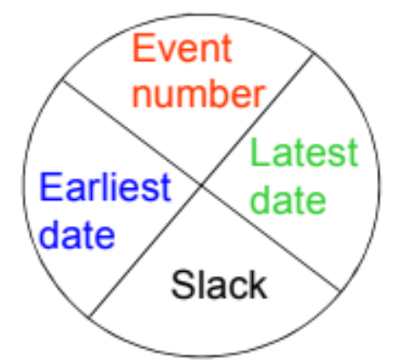
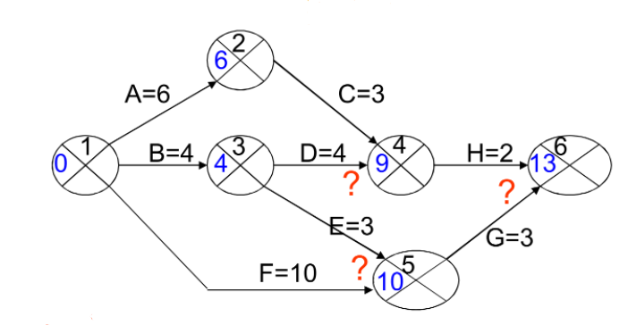
Network Analysis
The network is then analyzed by carrying out:
Forward Pass, to calculate the earliest date at which activities may commence and the project be completed.
Backward Pass, to calculate the latest start dates for activities and the critical path.
CPM Node

Slide 6
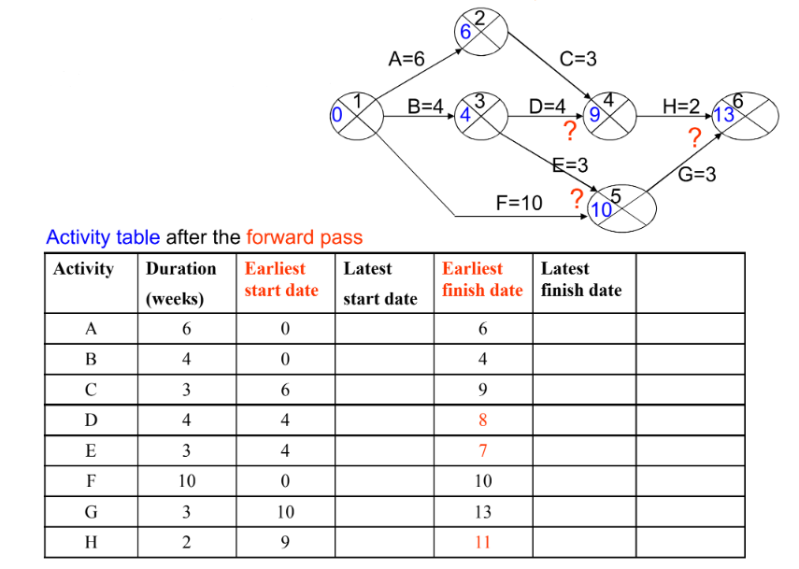
Forward Pass

Slide 7

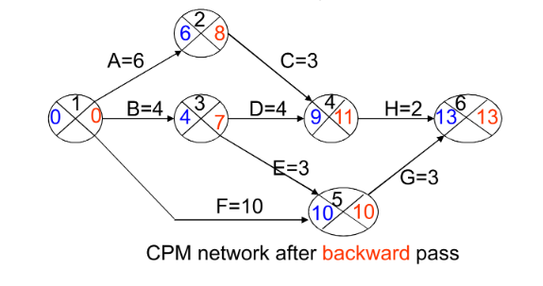
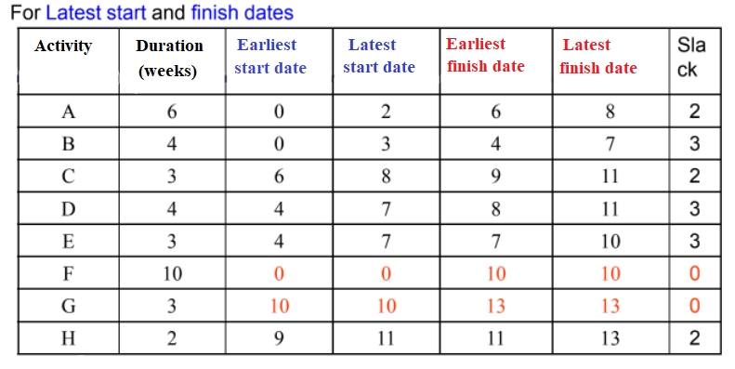
Backward Pass

Slide 8
PDM(Precedence Diagram Method)
Visual Representation Technique that depicts the activities involved in a project.
It is a method of constructing a project schedule.
Network diagram that uses boxes/nodes to represent activities and connect them with arrows.
used to show dependencies.

Slide 9
Lead and Lag
Lead and Lag are both used in the development of the project schedule
Lead: Accelerating the next activity.
Lag: lag is basically a waiting time between two tasks/activities.

Slide 10
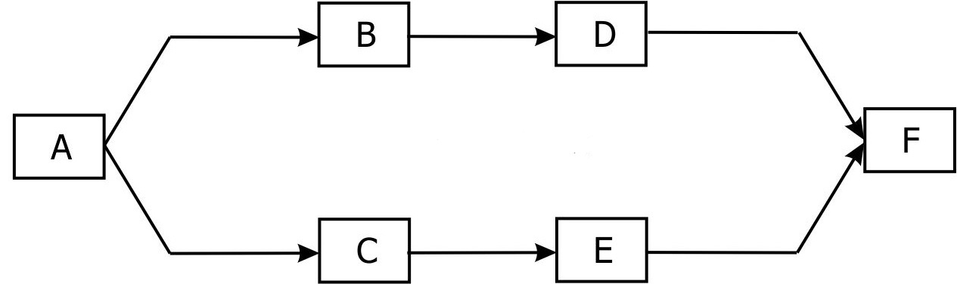
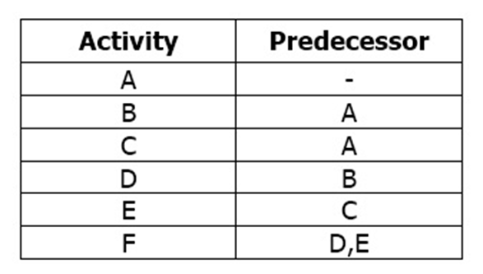
Structure of PDM
A,B,C,D,E & F are Activities/Tasks.
Arrows shows relation between activities
The predecessor is the first task, it controls the start or end date for all related successor tasks.

Slide 11
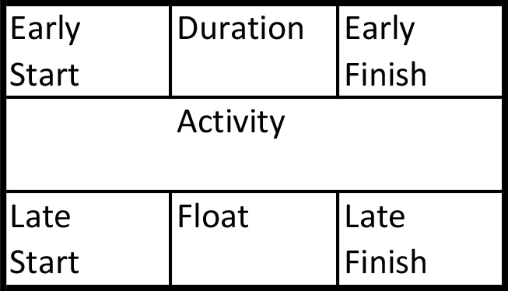
The Precedence Diagram
This box is apply to every task/activity that we perform in the project
Using formulas:
EF= ES + Duration
Float=LF-EF
Late start=LF-DURATION

Slide 12
Critical path
The sequence of stages determining the minimum time needed for an operation, especially when analyzed on a Software Project Management for a large organization.

Slide 13
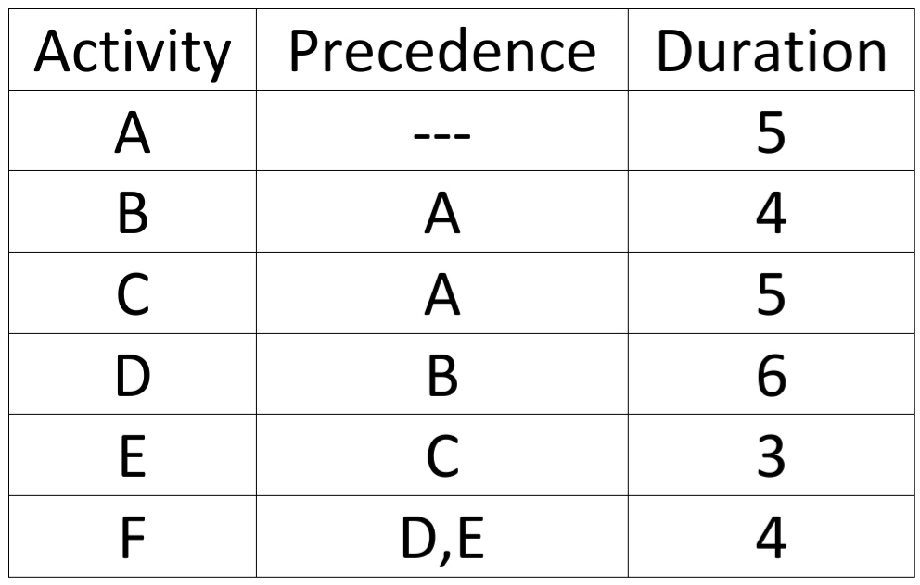
Find the critical path of this project?

Slide 14
How To Find Critical Path
ES | dur | EF
Activity
LS | Float | LF
5 | 4 | 9
B
5 | 0 | 9
9 | 6 | 15
D
9 | 0 | 15
Precedence Box/Diagram
15 | 4 | 19
F
15 | 0 | 19
0 | 5 | 5
A
0 | 0 | 5
5 | 5 | 10
c
7 | 2 |  | 12
10 | 3 | 13
E
12 | 2 | 15

Slide 15
How To Find Critical Path
ES | dur | EF
Activity
LS | Float | LF
Red arrows showing Critical Path
5 | 4 | 9
B
5 | 0 | 9
9 | 6 | 15
D
9 | 0 | 15
Precedence Box/Diagram
15 | 4 | 19
F
15 | 0 | 19
0 | 5 | 5
A
0 | 0 | 5
5 | 5 | 10
C
7 | 2 |  | 12
10 | 3 | 13
E
12 | 2 | 15

Slide 16
Gantt Chart
Introduced by: Henry Gantt
It is a graphical representation between activity and time.
Activities generally on: Y axis.
Time duration: X axis.
Activities are represented with the help of bar.
Length of a bar: time required for completion of an activities.

Slide 17
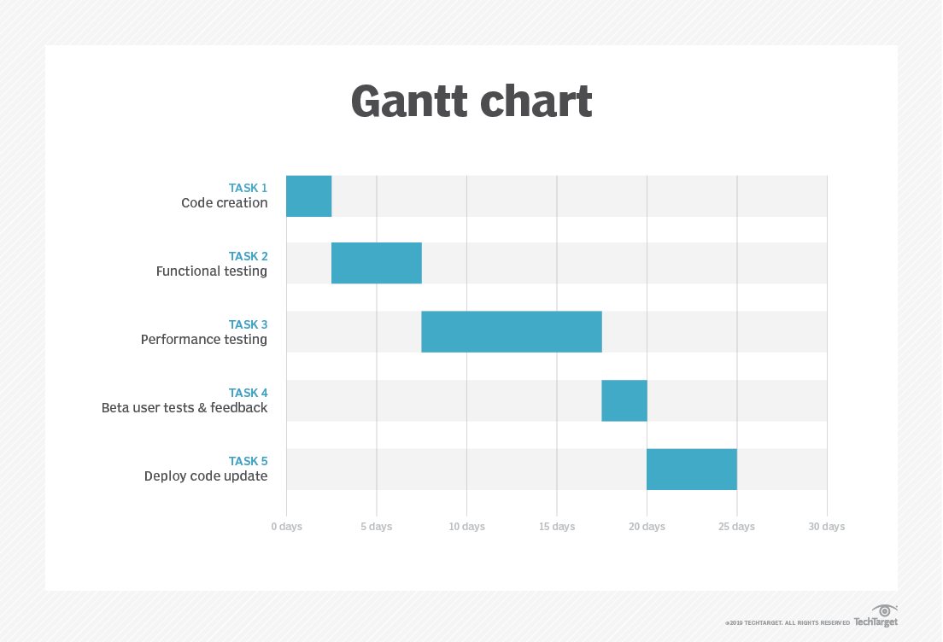
Gantt Chart

Slide 18
Advantages Of Gantt Chart
Easy to understand and simple to draw
Skilled person is not required
It can be used for determining resource requirement at a particular stage of a project

Slide 19
Thank you …

